Slide 1
Heathcliff and Edgar
Alexis Hahn

Slide 2
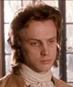
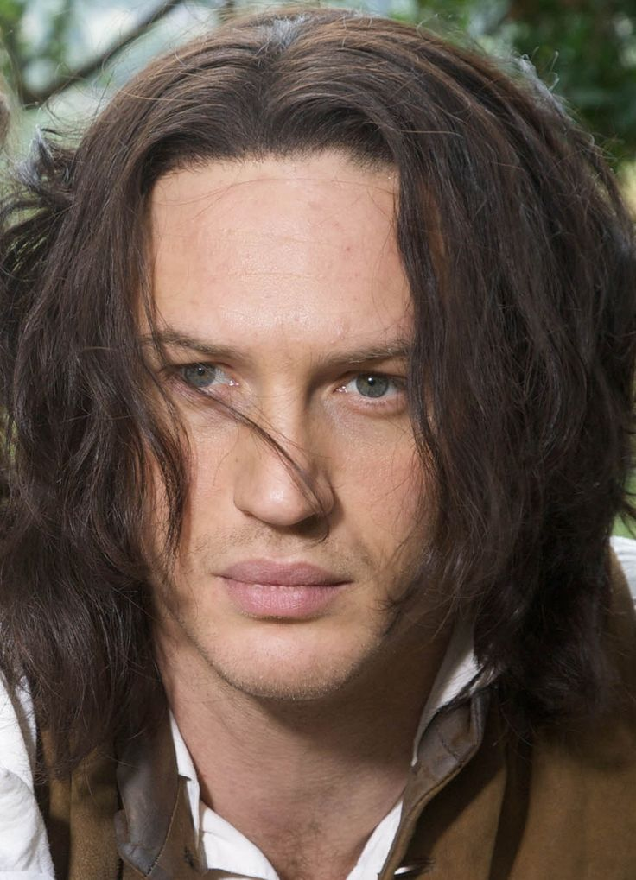
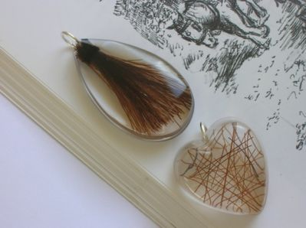
Fight
Edgar
Heathcliff

Slide 3
Quote
Heathcliff and Edgar both shared loved for Catherine and were constantly fighting over her. When Nelly says “except for the disarrangement of the drapery about the corpse’s face, and for observing on the floor a curl of light hair, fastened with a silver thread, which, on examination, I ascertained to have been taken from a locket hung around Catherine's neck. Heathcliff had opened the trinket and cast out its contents, replacing them with a black lock of his own. I twisted the two, and enclosed them together.” (Bronte. 164) This quote shows how even though Catherine is dead they are still fighting over each other for her. Catherine lived her life constantly having to choose between Heathcliff and Edgar. Catherine chose Edgar because she loved Heathcliff and wanted better for him. Also because Edgar was rich and Heathcliff lived in a lower lifestyle, this made the decision a little bit easier for Catherine.

Slide 4
Image Justification:
I chose to put a picture of Edgar and Heathcliff on each side of the poster. I chose to put the picture of the two hands ripping apart the heart because that’s what Heathcliff and Edgar are doing to Catherine, they are both constantly fighting over Catherine which is causing her to pick one which is hurting her because she wants both of them and doesn’t want to be in that position. I also choose to put the picture of the two locks of hair in the middle because Heathcliff and Edgar both put locks of their hair in the coffin with Catherine and then Heathcliff took out Edgar’s and replaced it with his, which shows that they are still fighting for Catherine even though she is already dead. Until Nelly goes and wraps the two locks of hair together and lays it in the coffin. That is why I choose the quote that says Heathcliff took out Edgar’s hair and out his own in replacement.

